Slide 1

ICC Cricket World Cup T20 2022 Data Analysis Presentation
Presenter: Imtiaz Faruk

Slide 2

Section 1
Overview of the T20 World Cup 2022

Slide 3
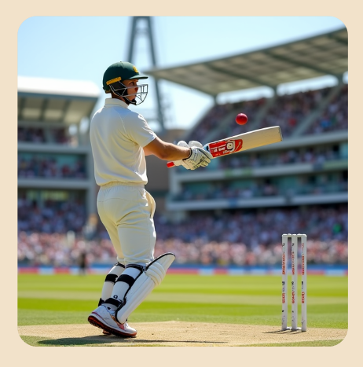
Introduction to the Tournament and Its Significance
Global Impact of T20 Format
The ICC Men's T20 World Cup 2022 not only showcased the competitive spirit of cricket but also significantly contributed to the sport's globalization, enhancing its appeal in non-traditional cricketing nations and fostering a diverse fan base through innovative engagement strategies.
Motion desi
HTMLS,JS
User exper

Slide 4
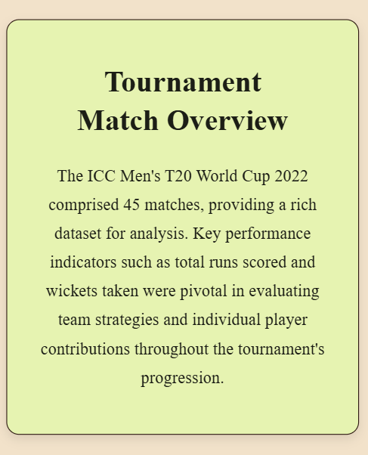
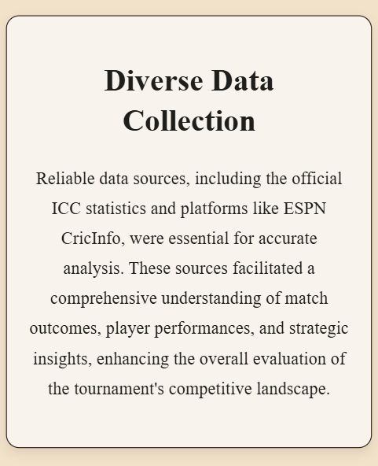
Key Statistics and Data Sources
Motion desi
HTMLS,JS
User exper

Slide 5

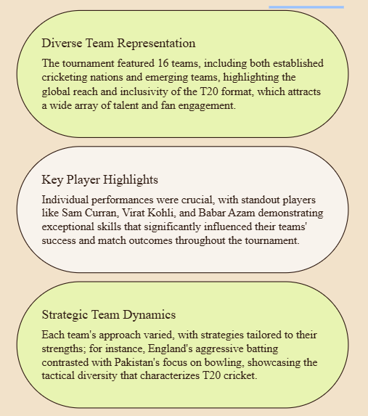
Overview of Teams and Players
Motion desi
HTMLS,JS
User exper

Slide 6
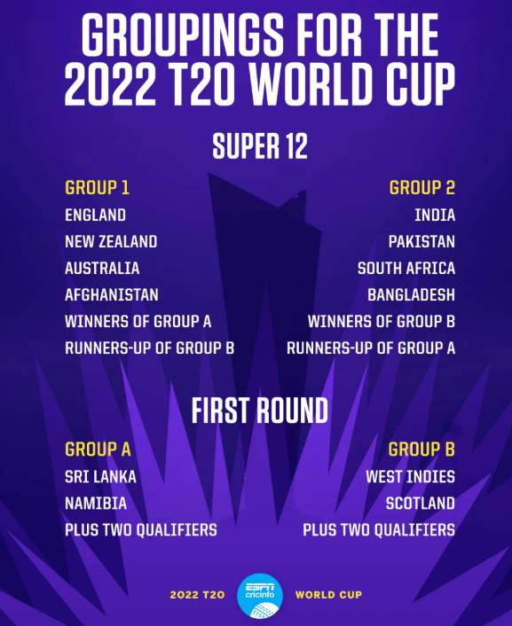
Tournament Structure and Stages
Comprehensive Tournament Design
The ICC Men's T20 World Cup 2022 employed a structured format comprising group stages, a Super 12 phase, and knockout rounds, ensuring a competitive environment that effectively evaluated team performances and facilitated the progression of the top teams towards the championship.
Motion desi
User exper

Slide 7
Section 2
Performance Analysis of Teams and Players

Slide 8
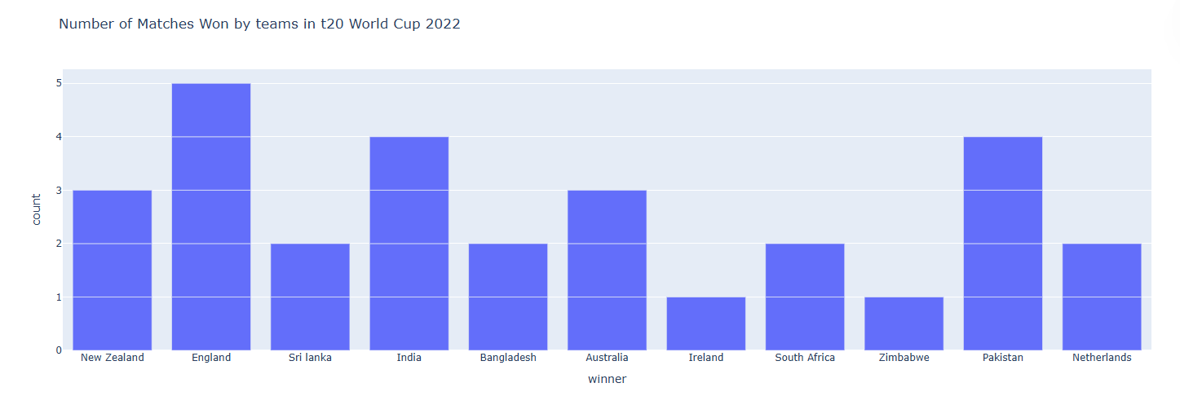
Number of match win (top 11)
Motion desi
User exper

Slide 9
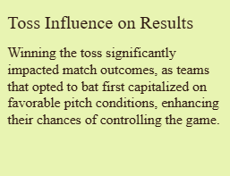
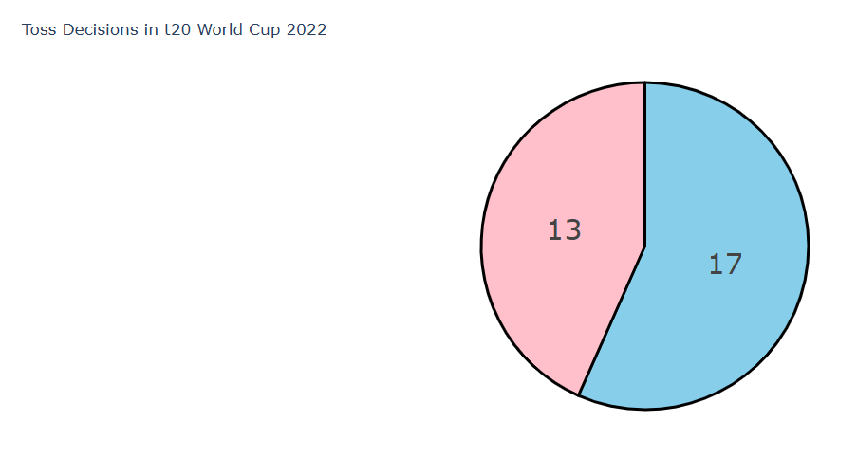
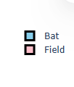
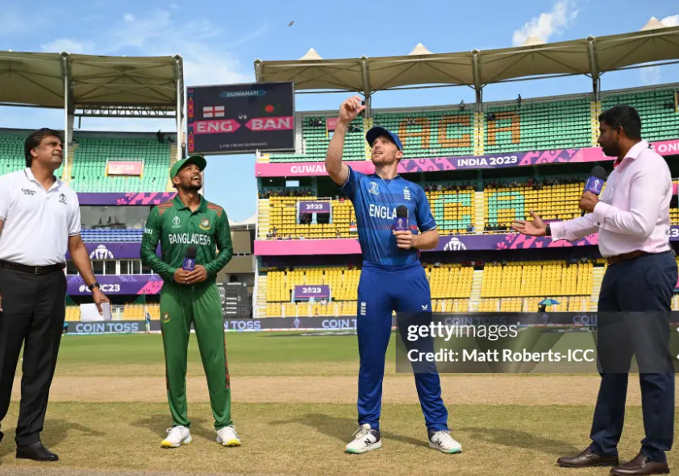
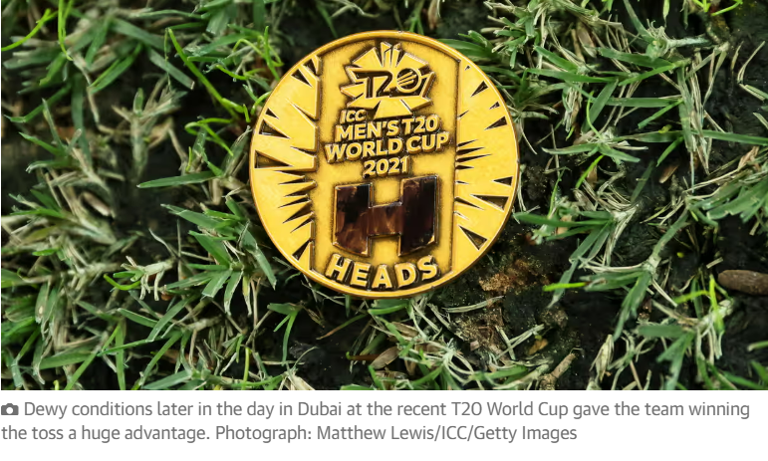
Toss Decisions (super 12)
Motion desi
User exper

Slide 10
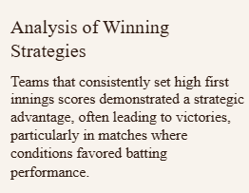
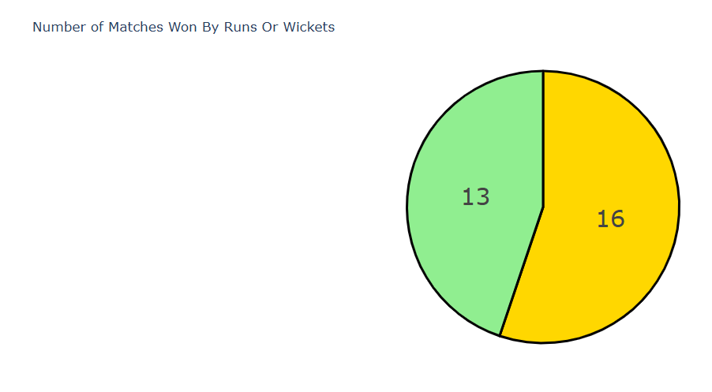
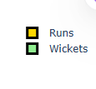
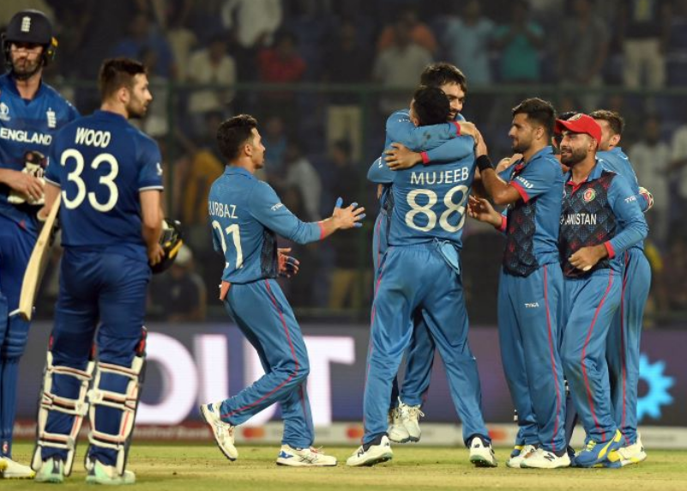
Chase Vs. Defend (super 12)
Motion desi
User exper

Slide 11
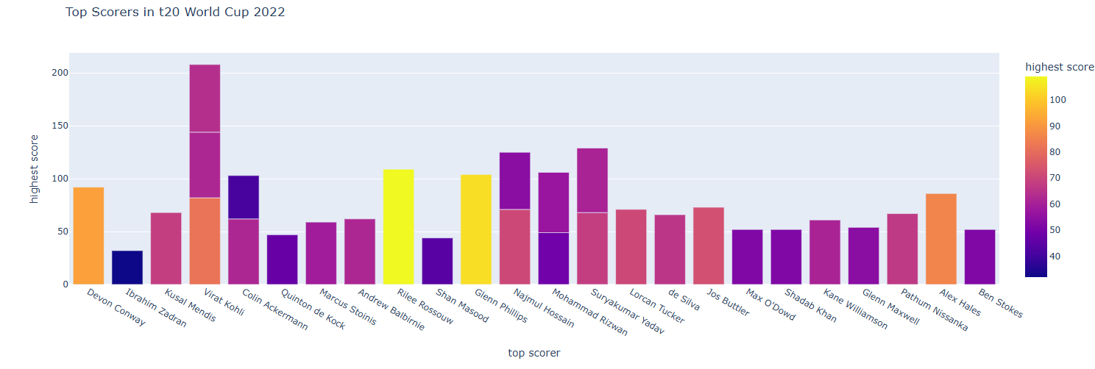
Top Scorer of the tournament
Motion desi
User exper

Slide 12
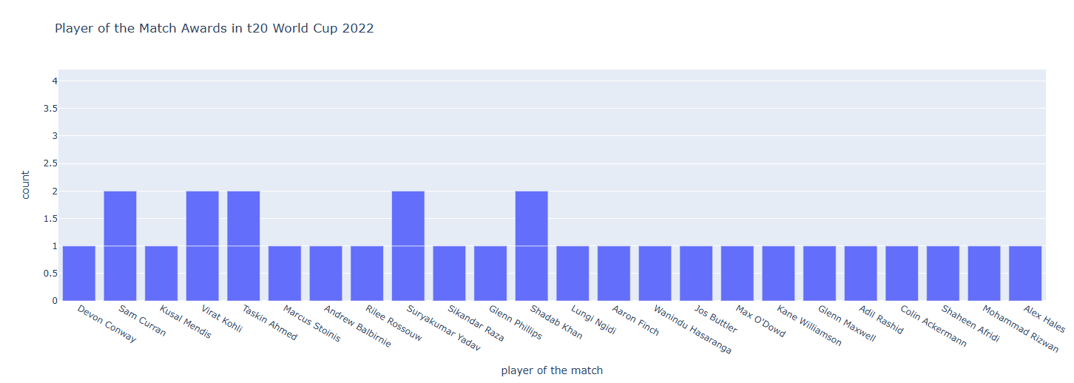
Number of M.o.M. in the tournament
Motion desi
User exper

Slide 13
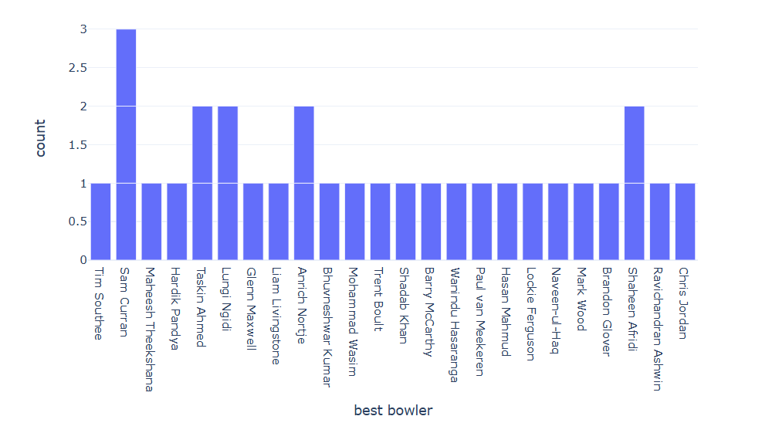
Best Bowlers of the tournament
Motion desi
User exper

Slide 14
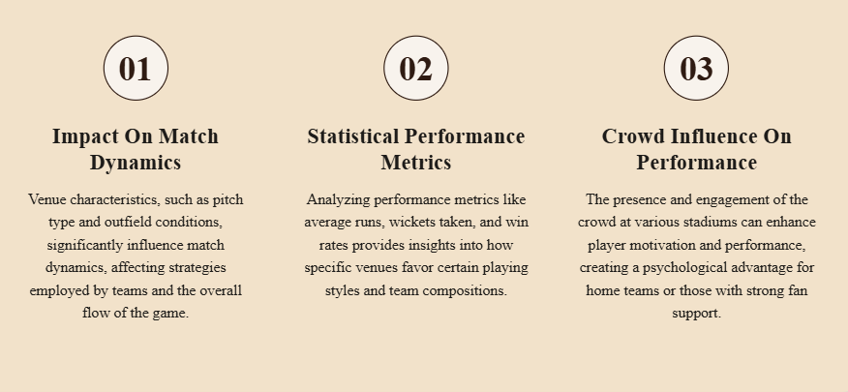
Best or Worst Stadiums
Motion desi
User exper

Slide 15
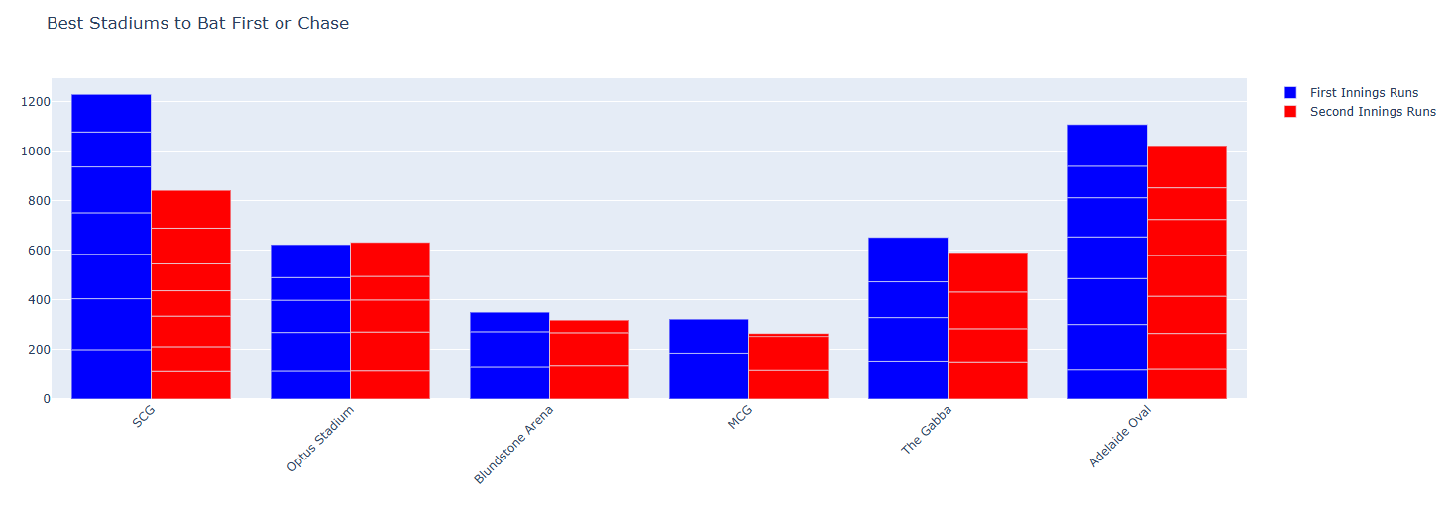
Best stadiums to Bat first or chace
Motion desi
User exper

Slide 16
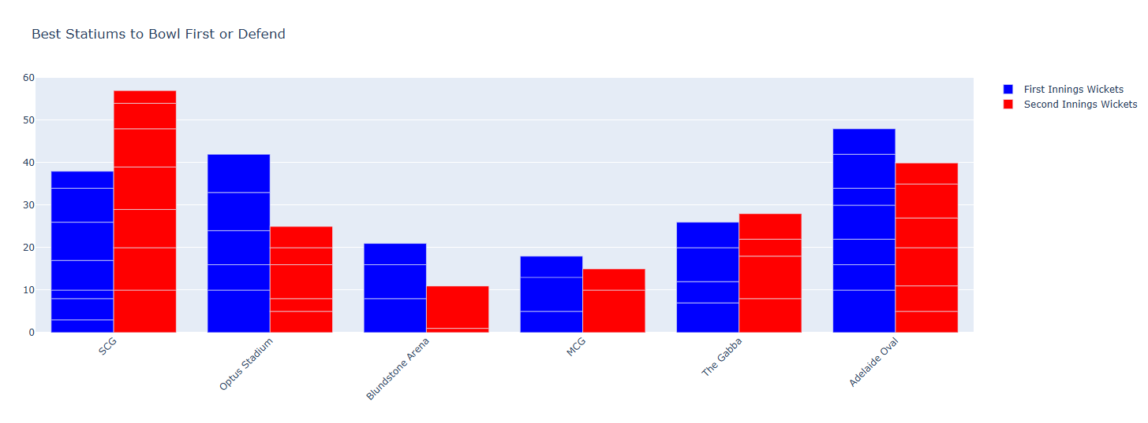
Best stadiums to Bowl first or defend
Motion desi
User exper

Slide 17
Section 3
Machine Learning Approaches for
Batting / Bowling Performances Vs. Match Win

Slide 18
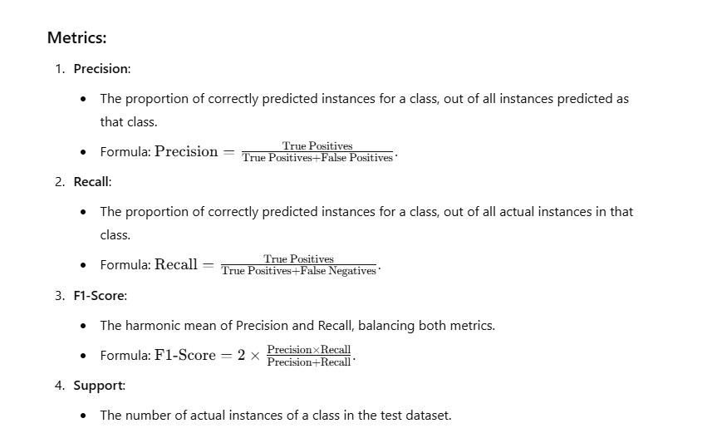
Statistical Analysis on Performances
I have decided to apply the Random Forest Machine Learning Algorithm to make an assumption both on Batting Performance for Winning the Match and Bowling Performance for Winning the match….
For these I used some Performance Matrices.

Slide 19
Statistical Analysis on Performances(for Batting)
Focus on Batting Features:
The predictions here are influenced by total runs and total wickets (a proxy for team dismissals or batting failures).
If a team's batting heavily influenced the match outcome, the model's ability to predict based on these features is reflected in the metrics.

Slide 20
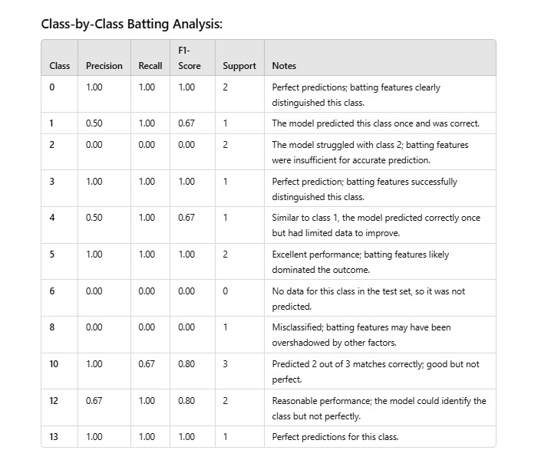
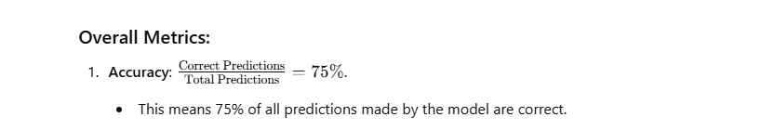
Statistical Analysis on Performances(for Batting)
Observations:
High Performers: Classes 0, 3, 5, and 13 show excellent predictions due to strong batting features distinguishing their match outcomes.
Sparse Data: Classes like 2 and 8 had poor predictions due to limited support, making batting features less effective.
Overall Balance: The model generally performs well when batting features (e.g., total runs) heavily influence the match results.

Slide 21
Statistical Analysis on Performances(for Bowling)
To incorporate bowling performance into the Random Forest model, I'll merge the bowling summary data with the current dataset and calculate additional team-level bowling features, such as:
Total wickets taken.
Average economy rate.
Runs conceded by the bowling team.

Slide 22
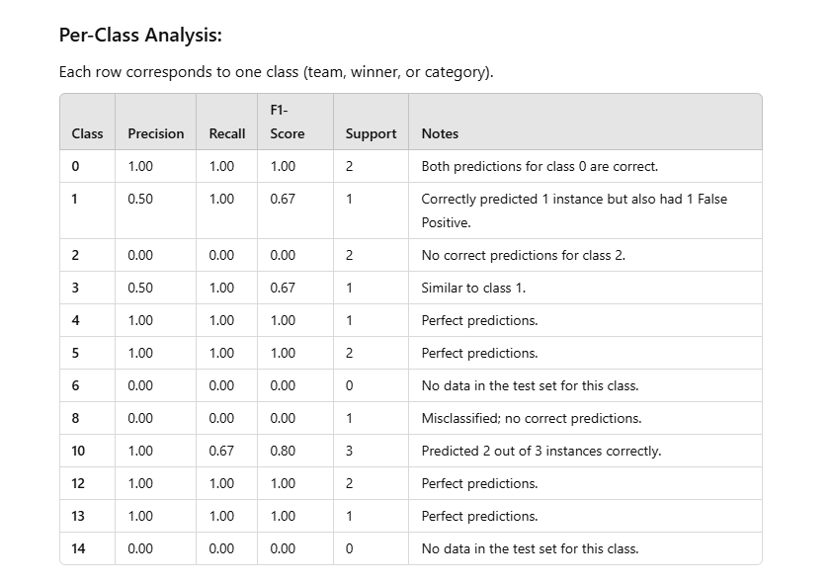
Statistical Analysis on Performances(for Bowling)
Observations:
Improved for specific classes (e.g., 0, 5, 10, 12).
Sparse data for classes 2, 8, and 14 remains a challenge.
Key Insights:
Incorporating bowling performance (e.g., wickets taken, low runs conceded and economy rate) helped to gain match winning performance.

Slide 23
Section 4
Power BI Visualization of Performances using DAX

Slide 24
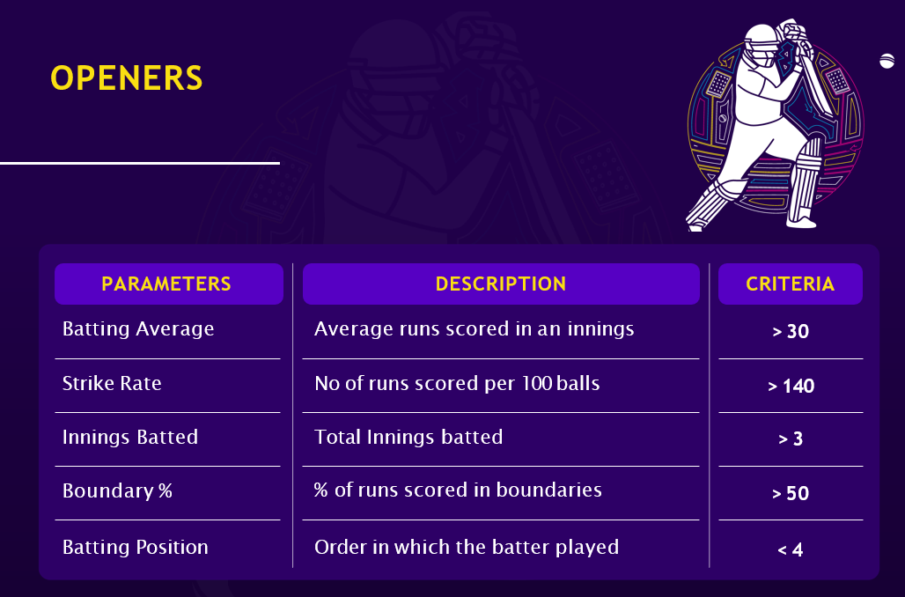
Parameters

Slide 25
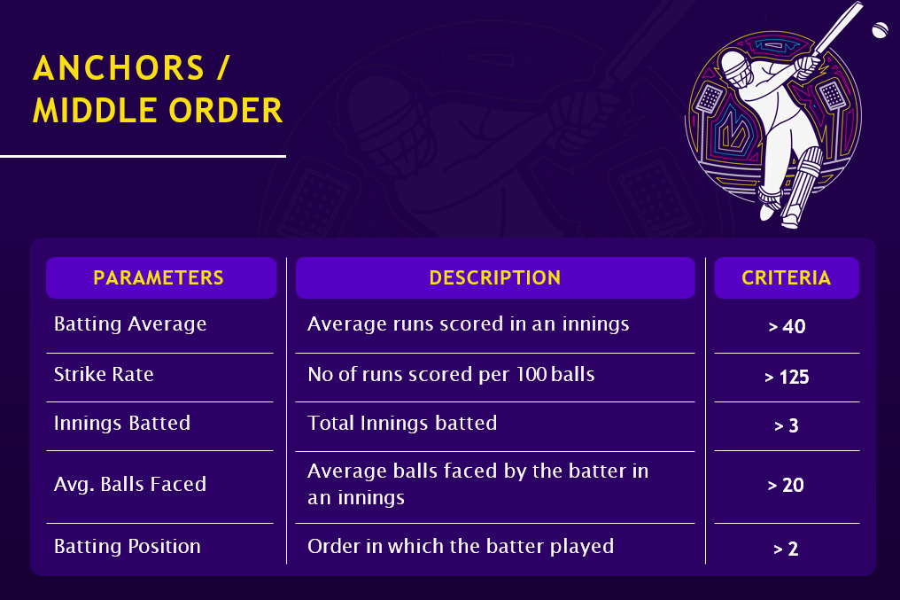
Parameters
Parameters

Slide 26
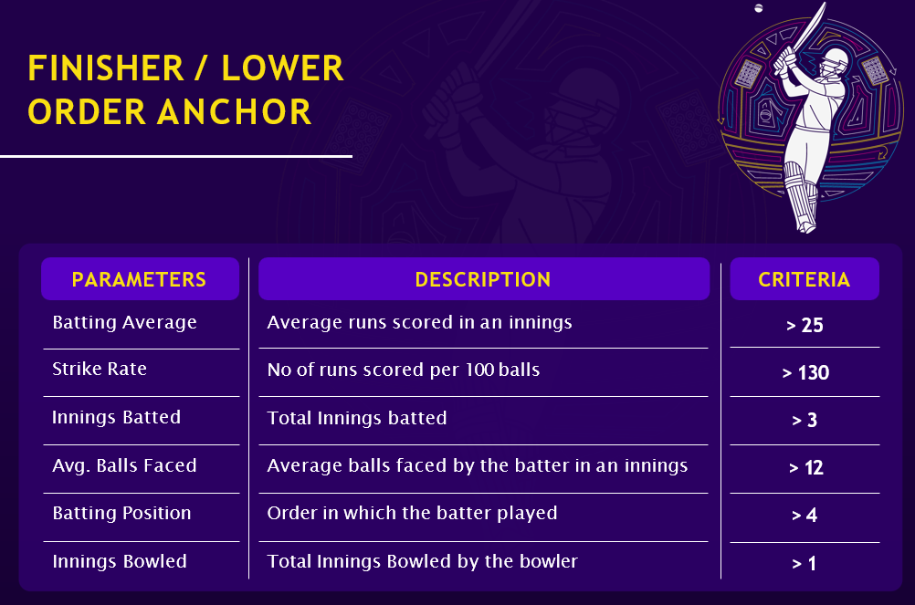
Parameters
Parameters
Parameters

Slide 27
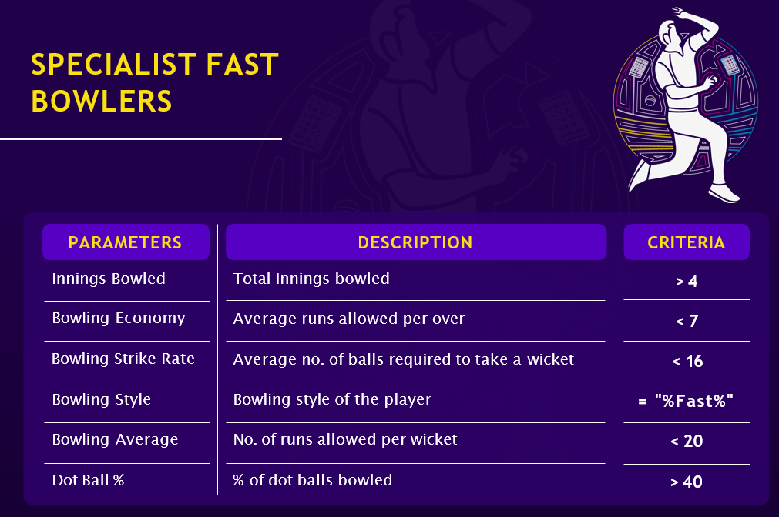
Parameters
Parameters
Parameters
Parameters
Parameters

Slide 28
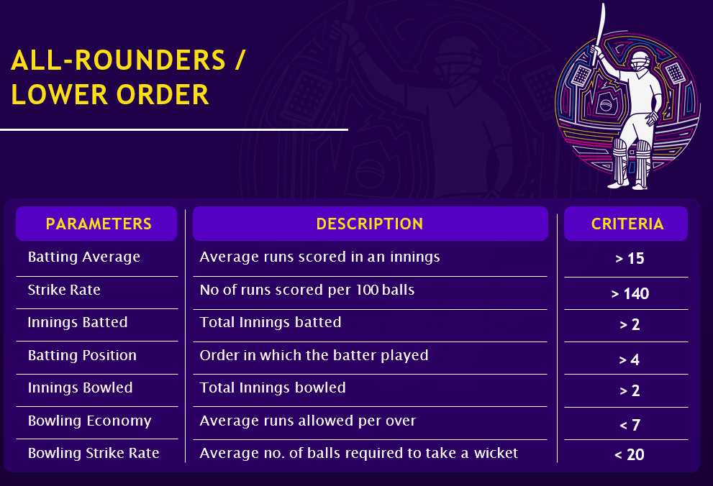
Parameters
Parameters
Parameters
Parameters

Slide 29
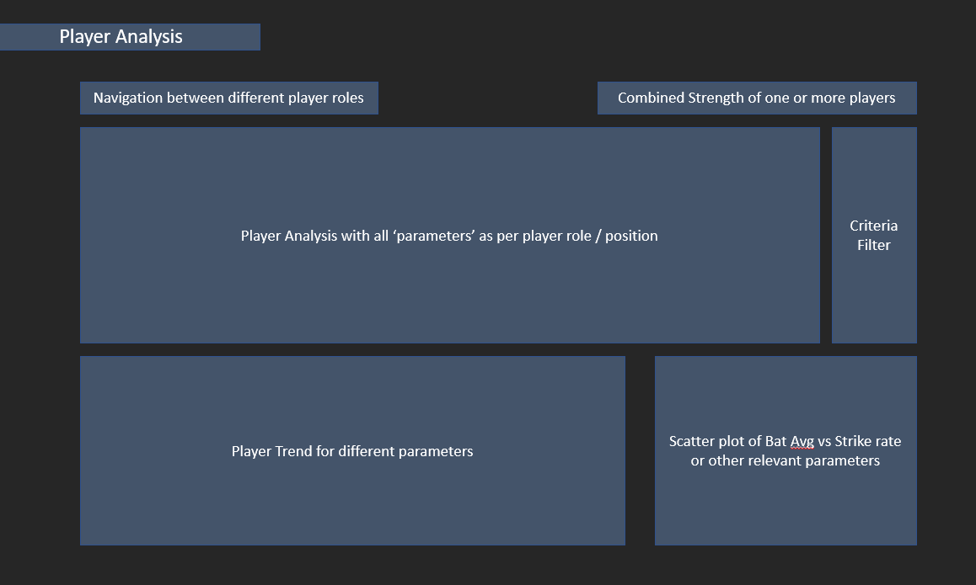
Parameters
Power BI Presentation
Parameters
Parameters
Parameters

Slide 30
Thank You

